Slide 1

Modernization Crossing the Digital Chasm

Slide 2

Contents
Market trends and drivers
Top modernization themes
Infosys modernization offerings
Mainframe modernization
Application & infrastructure modernization
Data landscape modernization
Infosys value proposition

Slide 3
Modernization is a key lever to drive business value and cloud led modernization initiatives are seeing a significant rise
Total Market Size
~90% of enterprises agree that legacy and monolithic applications are a major impediment to their application services
Source: Everest
60-80 B
5-7%
Growth in Application Services market is being fueled by Modernization Services
Source: Everest
Growth Rate
Market Size: Source – Gartner, Growth Rate: Source - Everest

Slide 4

Organizations must modernize their IT landscape to be a Live Enterprise!
MODERNIZE TO BE RESILIENT
EMBRACE CLOUD, ENHANCE ADAPTABILITY
Future-proof to a cloud-enabled architecture for evolving business needs
Transform legacy systems to modern digital technology stack for system resilience
REIMAGINE LEGACY. SUCCEED WITH CLOUD.
MODERNIZE TO BE RESPONSIVE
BE AGILE, INNOVATE FASTER
Adopt Agile and DevSecOps for responsive and secure IT systems
Innovate faster with Platform-centric modernization approach
MODERNIZE TO BE RELEVANT
BE EFFICIENT, UNLOCK BUSINESS VALUE
Leverage open-source software, cloud, smart automation, software asset optimization to reduce modernization cost
Improve stakeholder experience to derive maximum value

Slide 5


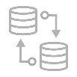
Top Modernization Themes
MAINFRAME MODERNIZATION
APP AND INFRA MODERNIZATION
DATA LANDSCAPE MODERNIZATION
Mainframe Rehosting
Mainframe DevSecOps
API Enablement
Mainframe Data Offload
Mainframe Re-engineering
App and Infra Decommissioning
Lift and shift apps to cloud
Technology & platform upgrades
App migration to containers
Monolith to microservices transformation
Legacy database to NoSQL or OSS RDBMS migration
App and Infra Decommissioning
Appliance to Cloud DW Migration
ETL tools/SQL to Open Source / Cloud Native ETL
Serverless ETL adoption
Hybrid Data Pipelines
Hadoop Data Lake to Cloud Migration

Slide 6




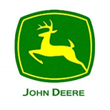
























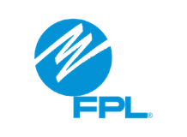

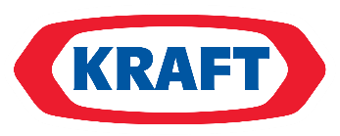


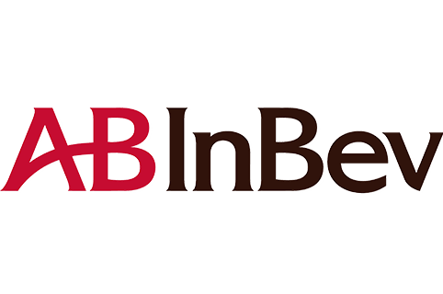


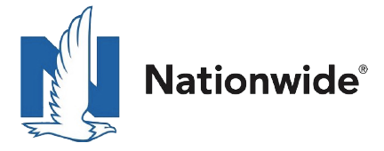


We are observing these key patterns under the three modernization themes across our top 200 clients
Oracle, DB2 & SQL Server to Open-Source DB (PostgreSQL, Mongo DB)
Application server upgrades
Framework / language migration and upgrades
DATABASE AND TECHNOLOGY MIGRATION
MAINFRAME MODERNIZATION
CLOUD MIGRATION
Rehosting mainframe to Microfocus
Rules Externalization, API-fication, DevSecOps
Real-time data offload from legacy
Rehost/remediate from on-premise to cloud
Re-platform to cloud
Containerize existing workloads to cloud
MODERNIZATION PATTERNS
DATA LANDSCAPE MODERNIZATION
API FIRST &
HYBRID CLOUD INTEGRATION
Polyglot and event-driven microservices
Serverless-based B2B API integration
Multi-hybrid cloud orchestration & integration platforms
Appliance to Snowflake migration
Open source/Cloud Native ETL migration
DW migration to data lake
EXPERIENCE &
APP
MODERNIZATION
Mobile First and Consumer grade experience
Adopt real-time business processes
Inclusion of speed layer in application design for better customer experience

Slide 7
Our comprehensive modernization offerings are driven by a portfolio of complementary platforms that aid hyper productivity
BUILD/TRANSFORM
RUN
“Infosys Modernization Suite” for App Modernization
Data Estate Modernization Suite
LEAP
Polycloud/Cobalt
Mainframe Modernization Platform
Database Migration Platform
Migration Platform
Cloud Native Development Platform
Cloud Modernization Platform
Data Landscape Modernization
Infra Modernization
Live Engineering
Infosys DevSecOps Platform
PolyCloud, AICloud

Slide 8
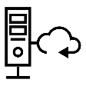
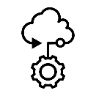
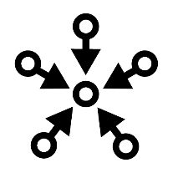

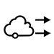
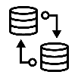









Infosys Modernization Suite – an integrated suite for end-to-end application modernization needs
INFOSYS MAINFRAME APPLICATION
MODERNIZATION PLATFORM
INFOSYS CLOUD NATIVE DEVELOPMENT PLATFORM
Integrated suite of tools for assessment, rules extraction and migration
Simplifies & accelerates the E2E lifecycle of hybrid cloud native applications
INFOSYS APPLICATION MIGRATION PLATFORM
INFOSYS CLOUD MODERNIZATION PLATFORM
Accelerates migration of technology and frameworks
Accelerates the public cloud adoption journey of workloads, supporting various migration patterns
INFOSYS DATABASE MIGRATION PLATFORM
End-to-end, hyper-automated platform for database migration

Slide 9

MAINFRAME MODERNIZATION

Slide 10
Mainframe Modernization – Operations Evolution
Current Mode of Operations
Modernization Patterns
Future Mode of Operations
User Experience
Non user-centric, rigid & complex
Steep learning curve
Terminal based UI
Architecture
Monolith, Batch centric
Data silos
Technology
Proprietary (COBOL, JCL, CICS, DB2)
Process
Waterfall
Longer release cycles
Operations
Data centers, self-managed
Siloed teams
Point automations
User Experience
User-centric, personalized, responsive
Unified omni-channel experience
Architecture
µServices, Distributed, Event-driven
Data unlocked for deep insights
Technology
Open Source, ‘Cloud first services’
Process
Distributed Agile
Shorter release cycles
Operations
Infra on cloud, managed services
Integrated DevSecOps teams
Automation-native
Mainframe Rehosting
Mainframe DevSecOps
API Enablement
Mainframe Data Offload
Mainframe Re-engineering

Slide 11

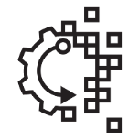
Mainframe Modernization – Key Activities
ANALYSIS
HYBRID REVERSE ENGINEERING
DATABASE MIGRATION
FORWARD ENGINEERING
DECOMMISSION*
Active inventory identification | Business Glossary | NFR discovery | To-Be process model creation | Prepare & Plan – App/Data/Server
As-is process model creation | Dynamic call dependencies | Schema migration / conversion to RDBMS or NoSQL | Architecture definition & environment provisioning | Backup source code and data
Seed programs mapping | Rules extraction & categorization | Database code conversion | UI prototyping & design | Turn off Services – App/Logs
Baseline inventory & smart allocation for BRE | Rule chaining, review & rule repository creation | Data migration & testing | Microservice & UI code creation | Release Licenses and Hardware
 | Database schema and code reverse engineering | NFR validation | DevSecOps pipeline creation | Update CMDB/ITSM Tools
 | Produce FRD and BRD documents* |  | Observability and telemetry
MONOLITHIC
APPLICATIONS
MICROSERVICES
Steps involved
Platforms involved: Mainframe Modernization, Cloud Native Development, Cloud Modernization, Database Migration

Slide 12




Mainframe Application Modernization Platform
Goal
To build a platform that parses and ingests all type of legacy code and non code artifacts and derives meaningful insights. Accelerates legacy system understanding by 50% and automated conversions [simple use cases] by 80%
Modernization Paths
Application
Transformation
Rehosting
API enablement/ Refactor
Application Migration
Mainframe
Data offload
DevSecOps
Application Decommissioning
Key Features
Existing
Upcoming
Inventory Baseline*
Call Chain/ Dependencies *
Rehost complexity*
Bidirectional traceability
STATIC CODE ANALYSIS
ROI Calculation
DDLs for VSAM/ Files
Knowledge Curation
HYBRID CODE ANALYSIS
Dynamic calls from programs
Disentanglement
AS-IS process flow
Dynamic Jobs discovery
LOG ANALYSIS/ NFRs
Critical & SLA bound jobs
Frequently run jobs
Active Vs Inactive inventory
Scheduler dependencies (Control-M)
Storage, memory & perf. testing needs
Batch workflow
Capability level grouping*
Rule chaining*
Rules coverage*
Auto classification of rules
BUSINESS RULES EXTRACTION
Business Rules repository
Data Lineage
PII data search
Rules flowchart
Annotate code/ text for FE
Based on Open Source
Specific to Rehost
MIGRATION
PL/1 to Java
Utilities replacement
Translate code for rehost
* Present both in Infosys IP and 3rd Party tools

Slide 13
Mainframe Application Modernization Platform
END-STATE – 50% AUTOMATION
STATIC CODE ANALYSIS
DYNAMIC CODE ANALYSIS
LOG ANALYSIS/ NFRs
BUSINESS RULE EXTRACTION
MIGRATION
Inventory Baseline
Call chain/ dependencies
Migration complexity
Dynamic program calls
Dynamic jobs discovery
Disentangle legacy entities to form application groups
As-is Process flows
Active Vs inactive inventory
Critical job identification
Scheduler dependencies
Rules classification
Rules catalog & chaining
Business rules repository
Utilities mapping
Clean compile & test
* Highly automated
* Partially automated
KEY UPCOMING PRODUCTIVITY BOOSTERS
Scheduler Dependencies
Dynamic Program Dependencies
Annotation based code generation
Enables analysts to understand the batch process flows and internal/ external dependencies better. It also helps in accelerating identification of inactive jobs.
Ability to identify potential dynamically called programs and submitted jobs, by intelligent parsing of code based on patterns fed to the platform
Annotate reverse engineered business logic and flow. Generate secured code from legacy to target technology
Why?
Why?
Why?
Batch processes play a crucial role in legacy systems. For e.g. ~90% of Vanguard legacy systems are batch oriented.
Process flows and call chains are interrupted when dynamic calls are made from programs, which hinders analysis
Essential bridge to automated code development from legacy code and business logic.
Benefits
Benefits
Benefits
Accelerates understanding of AS-IS batch workflows. Effort reduction of ~ 30% in batch analysis, if an all-in-one view is provided
Effort reduction of ~ 30% in capability level grouping exercise
Enables creation of services for select code snippets with increases the code readability and maintainability

Slide 14

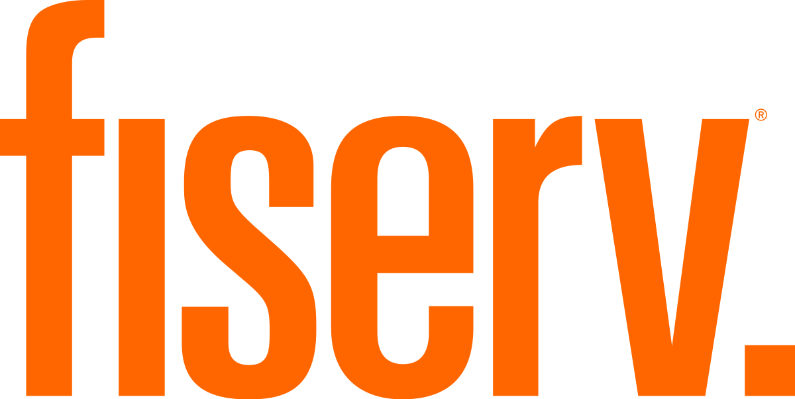
Cloud Native Development Platform – API & Service Layer
Goal
Build - Enable developers, testers to focus on writing functional code by generating non-functional code, test cases. Automation goal: 50%
Operate – Simplify day 2 operations. Effort Savings Goal – 40%
Modernization Paths
Greenfield Application Development
PCF to Kubernetes migration
Migration between multiple Kubernetes platforms
Existing
Upcoming
Key Features
ASSESS
OSS Evaluation
Cloud Native Application Assessment
Document Search, Extraction, Digitization
DESIGN
µservices Designer
API Designer
µservices Workflow, Integration
Batch Designer
µservices Archetypes
PROVISION
K8s Cluster Provision
Software Provision
Service Mesh
Container Native Storage
S/W upgrade, Redeployment
Config based µservice generation
µService Binding
µService Communication
K8s App Remediation
Cloud Services Integration
Remote Container Debugging
DEVELOP
DevSecOps Integration
Utility functions#
Mono2Micro Traceability
µService Security
Knative, Quarkus support
Reusable plugins, libraries
TEST
Behavior-driven testing
Service virtualization
Unit testing
Performance testing
Configurable and integrated testing workbench
OPERATE
Metering
Observability
OSS Observatory
End-to-End Telemetry integrating cloud services
Based on Open Source
Container security*
Container Management*
Predictive analytics
SRE Bots
* 3rd Party tools
# Utility functions include logging, monitoring, tracing, exception handling, secret management etc.

Slide 15
Cloud Native Development Platform – API & Service Layer
END-STATE – 40% AUTOMATION
ASSESS
DESIGN
PROVISION
DEVELOP
TEST
OPERATE
Architecture Selection
Application Assessment
Design API and Microservices
Design Batch applications
Kubernetes Cluster Provision
Software provision on containers
Microservice/batch code generation
Application remediation while migrating to Kubernetes
Cloud Services integration
DevSecOps integration
Generate unit, functional, and performance test cases
Manage test execution
Open-source software metering
Manage software vulnerabilities
Container management
End to end Telemetry
Application debugging
* Highly automated
* Partially automated
KEY UPCOMING PRODUCTIVITY BOOSTERS
Enhance development automation
Advanced Telemetry & troubleshooting
Integrated test workbench
Provide multiple microservices patterns. Add new capabilities viz. batch design, enhanced code automation. Template-based non-functional code generation with reusable utility components.
Provide and end to end monitoring and real-time insights of distributed application. Ease developer effort in troubleshooting and debugging application on containers.
Integrate test automation with the design and development automation.
Why?
Why?
Why?
~50% of the development lifecycle effort is spent on writing non-functional code with less focus on following organizational coding guidelines.
Distributed nature of application components makes its difficult to monitor end-to-end. Realtime debugging of application components is a challenge.
Lack of testing traceability with design, hence missing out on critical NFR while testing .
Benefits
Benefits
Benefits
Enhanced application development productivity up to 40%, code standardization
Reduce the troubleshooting effort by 10-15x times.
Enable shift left testing to uncover early failures

Slide 16



Cloud Native Development platform – UX Layer
Goal
Significantly improve productivity by at least 40% across the entire UI lifecycle from prototyping to testing
Modernization Paths
Re-design and development
AngularJS to Angular migration
Flex to Angular migration
Key Features
Existing
Upcoming
PROTOTYPE
Drag & drop wireframe creation*
Existing page capture*
Annotation & Review*
Wireframe template & component repository
Live Enterprise Design
Component Repository*
CSS generation*
VISUAL
DESIGN
Drag & Drop Designer*
Annotation & Review*
Live Enterprise Design, Experience Configurator
Dynamic behavior-driven UI
Flex/AngularJS to Angular
Version consistency
Micro-frontend Repository
DEVELOP
Templates, component repository & patterns
Drag & Drop UI generation
UI to API / service binding
IDE integrations
Integrated design to development
App flow recording
Behavior-driven testing
UI performance
Security*
TEST
Consistency & Accessibility
Browser compatibility
Service virtualization
Self healing test scripts
Based on Open Source
OPERATE
Observability
Telemetry
* 3rd Party tools

Slide 17
Cloud Native Development Platform – UX Layer
END-STATE – 50% AUTOMATION
PROTOTYPE
DESIGN
DEVELOP
TEST
OPERATE
Create wireframes
UI design based on Design System components
Define program UI templates
Develop UI components
Define UI layouts
Develop UI code
Bind UI to microservices/APIs
Service virtualization for API/service mocking
Test script generation & execution
Performance testing
Security testing
Browser compatibility, consistency, etc.
Telemetry
Logging
* Highly automated
* Partially automated
KEY UPCOMING PRODUCTIVITY BOOSTERS
UI Generator
Integration of features from disparate IPs
Enhance template & component repository
Allow developers to intuitively define layout via drag & drop, generate UI code and bind components to APIs. This will be a reusable and extended version of the Finacle UI workbench
Integrate required features from tools for development testing, observability, telemetry, with IDE integrations where needed
Add more UI templates and components to the repository to provide additional quick-start start capabilities
Why?
Why?
Why?
~70% of the development lifecycle effort is spent on manually developing and reworking screens due to complexity and lack of standardization
We currently have many different tools that developers & testers need to use, leading to loss of productivity and increased rework
A larger repository will provide developers more flexibility to chose components out of the box and further reduce development time
Benefits
Benefits
Benefits
Enhanced UI productivity by 30-40%, design standardization
Reduced manual handovers, improved productivity
Enhanced UI productivity by 30-40% due to reusable assets

Slide 18





Database Migration Platform
Goal
An extreme automation database migration workbench that will aid in database reverse and forward engineering and data migration.
Modernization Paths
RDBMS to RDBMS
Lift & Shift
RDBMS to RDBMS
Transformation
RDBMS to NoSQL
Transformation
Non-RDBMS to RDBMS/NoSQL
Transformation
Key Features
Existing
Upcoming
ASSESSMENT & ARCHITECTURE
Database Discovery
Target Recommendation
Database Dashboard
NFR Collection
Profiling & Classification
ERD Creation*
NoSQL Schema Refactoring
NMT
NFR Validation
Schema Cleansing*
SCHEMA & CODE
Migration
Schema Traceability*
Migration
Validation
KeyStore for DB credentials
Data Traceability
DATA
Cleansing & Masking
Golden Record
Regulatory Compliance (HIPAA, PCI DSS)
NoSQL Migration
Template driven data pipeline creation
Data Attribution History
SOURCE & TARGETS
Technologies supported: 10
Based on Open Source
* 3rd Party tools

Slide 19
Database Migration Platform
END-STATE – 30%- 80% AUTOMATION
ASSESSMENT
SCHEMA & CODE MIGRATION
DATA MIGRATION
Database Discovery
Target Recommendation
NFR Collection
As-is ERD Creation
Schema Cleansing
To-Be ERD creation
Schema migration
Database code conversion
Code Validation
Data Cleansing & Masking
Data Migration
Data Validation
NFR Validation
* Highly automated
* Partially automated
KEY UPCOMING PRODUCTIVITY BOOSTERS
Additional Source/Targets
Dynamic SQL conversion
NFR collection & Validation
Add support for DB2 & SQL Server.
Automated conversion of dynamic SQL statements in SP/Java/.NET.
Automated gathering and AI matching of as-is query performance and throughput stats.
Why?
Why?
Why?
Clients have a diverse legacy landscape that includes multiple database technologies. Single platform to convert most of them will be a very valuable ability
Applications with dynamic SQL require significant manual effort to convert them to target DB.
The biggest pain point felt during testing of target system in lift and shift migrations is poorly performing SQL.
Benefits
Benefits
Benefits
Highly automated conversion for complex portfolios to different targets as required.
Partial automation of conversion can save 30% - 40% effort for converting dynamic SQL code to target database.
Throughput and performance metrics of source and target systems can be systematically captured. Identification and fixing of low performance queries can save 20% – 30% spent in PT/UAT phases.

Slide 20
Feature Rollout Plan – Mainframe Modernization
6 weeks
12 weeks
18 weeks
Bidirectional traceability for DB elements from codebase
Online process flows by capabilities
Scheduler dependencies
Batch Process flows by capabilities
Flowchart on extracted business logic
Annotation based secured code migration
DDLs from VSAM/ files
Dynamic jobs and programs’ discovery
Annotate code for FE needs
Auto classification of rules
Mainframe
Application Modernization
Cloud Native UX Layer
UI generator – create reusable version of Finacle tool
Enhance UI generator to work with Live Enterprise Design components
Integration of features from disparate IPs
Enhance template & component repository
Cloud Native Business Layer
Batch Application design workbench
End to end Telemetry
Automate, ease cloud services integration
Batch code generation
Integrate behavioral, parallel, API/contract testing workbenches
SRE operational Bots development
Database Migration
Add support for DB2 for Portfolio Assessment, Schema migration
NFR Collection and Validation
Dynamic SQL Conversion for Oracle, DB2

Slide 21
APP & INFRA MODERNIZATION

Slide 22
Infrastructure Modernization – Operations Evolution
Current Mode of Operations
Modernization Patterns
Future Mode of Operations
Lift and shift apps to cloud
Technology & platform upgrades
App migration to containers
Monolith to microservices transformation
Legacy database to NoSQL or OSS RDBMS migration
Architecture
Infra based resiliency, design for peak, static scalability
Technology
Traditional infra vendors (IBM, Dell EMC, HP, Cisco), Large Platform OEMs (IBM, Microsoft, Oracle, Informatica)
Process
Waterfall, Longer release cycles
Operations
Individual Infra Tower, process centric & people based, Service request based, complex SIAM
Architecture
µServices, Distributed, Event-driven
Resiliency from platform technologies and application architecture
Intrinsic scaling and network centric dynamic deployments
Technology
Cloud (hyperscalers), hyper converged Infra (Nutanix, HPE), Software defined (DC, Network, & storage), open source, edge computing
Process
Distributed agile, non disruptive deployment, continuous release
Operations
Developer empowerment, Service centric, DevSecOps & Site reliability engineering, observability & automation driven operations

Slide 23


Cloud Migration – Key Activities
DISCOVERY & ASSESSMENT
CLOUD INFRA SETUP
UPGRADE & MIGRATION
TEST & GO-LIVE
DECOMMISSION
Application discovery | Setup Landing Zone | Technology Upgrades (25+ patterns) | Infrastructure Verification | Prepare & Plan – App/Data/Server
Application assessment | Provision Application Environment | Data Migration (5 key patterns) | Migration verification – App/Data | Backup source code , data ( Hot & Cold Archival)
Cloud Infra Sizing | Setup and Rollout DevSecOps | Adopt Managed Cloud Services | Performance Testing | Turn off Services – App/Logs
Wave Planning & Roadmap | Setup Cloud Operations (Monitor, Patch, Backup) | Containerization | Security and Compliance | Release Licenses and Hardware
TCO Analysis | Define Operating Model | Lift and Shift - Server Migration | Cutover | Update CMDB/ITSM Tools
Apps On-Prem
Apps on Cloud
Steps involved
Platforms involved: Cloud Modernization, Database Migration, Application Migration

Slide 24








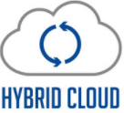
Cloud Modernization Platform
Goal
Accelerate cloud migration & modernization with ready-to-use solutions for multiple patterns & cloud providers.
Modernization Paths
Technology
Upgrades
Replatform to OS platforms
Workload Containerization
Move Workloads into Cloud Native PaaS
Modernize using Serverless
Existing
Upcoming
Key Features
Discovery*
Disposition
Cloud Readiness Index*
Enhance & Integrate ROI Calculator
Cloud affinity View
ASSESSMENT
Cloud Foundation Assessment
PaaS and Container suitability check
Cloud Recommendation Report
UPGRADE & MIGRATION
Prog Lang / Framework Upgrades (JDK,PHP)
Database Migration (Vertical/Horizontal)
OS Upgrades
-HP- RHEL Shell Scripts
Framework Version
Upgrades
CLOUD INFRA SETUP
Landing Zone Setup
App Environment Provisioning
Provisioning for cloud agnostic setup
CLOUD NATIVE -
CONTAINERS, PAAS & SERVERLESS
App containerization
ECS, EKS, AKS & GKE
AWS Elastic Beanstalk - Provision and Deploy
Azure App Service – Provision and Deploy
Setup for Cloud Native App Architecture Patterns
Container Image Scanning*
Serverless – TCO calculator, template provision and deploy
Support for Container on CSP PaaS
OPERATE
Cloud Spend Analysis
Cloud Optimization*
(integrate with 3rd party)
CLOUD SERVICE PROVIDERS
* 3rd Party tools

Slide 25
Cloud Modernization Platform
END-STATE – 30-40% AUTOMATION
Discovery
Assessment
Modernize/Migrate
OPERATE
Application and Infrastructure Data Discovery
Automated Cloud Assessment
Cloud Disposition and Migration Estimation
Code Assessment for Cloud Suitability
Vertical & Horizontal Upgrades - PL/Frameworks/Middleware/OS/DB
Quick Start Templates for Cloud App Architecture Patterns
Containerize & migrate existing applications to Managed Kubernetes
Container Image Scanning
Cost Optimization
* Highly automated
* Partially automated
KEY UPCOMING PRODUCTIVITY BOOSTERS
Infra-as-code for App Architecture Patterns
Horizontal and Vertical Upgrades
End to End flow to setup components for App Architecture Patterns
Accelerate application upgrades by assisted features for PL, App/Web and framework upgrades
Why?
Why?
Effort Optimization & reduced dependency on SMEs for setup
Consistent requirement to upgrade to cloud compatible version and reduce tech debt.
Benefits
Benefits
Standardized templates and 30% effort reduction
Provide accurate estimates for migration and assist developers to accelerate migration by 30%

Slide 26






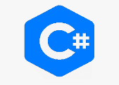

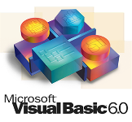

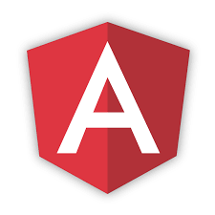


Application Migration Platform
Goal
An Intelligent migration automation solution which helps the application modernization objectives (Forward/reverse engineering) by accelerating the Technology, Framework and Architecture migration with build effort savings 30% to 50%.
Modernization Paths
Technology Migration (e.g. VB6 to C#/WPF)
Framework Migration
(e.g. Struts 1 to Spring 5)
App Server Migration
(e.g. Weblogic to JBoss)
Business rule Extraction
(e.g. Java, Oracle)
Key Features
Existing
Upcoming
APPLICATION HEALTH ANALYSIS
Architecture view*
NFR analysis*
Efficiency Calculator
Data driven migration planning
BUSINESS RULE EXTRACTION
Code base visualization
Business rules extraction & Documentation
Business Flow based rules
TECHNOLOGY MIGRATION
Technology
App Servers
Frameworks
Java to Go
Angular 1 to Angular 9
MIGRATION ASSURANCE
Visual flow verification
Migrated Code Comparison
NFR Recommendations*
Test Script Migration and Verification
Functional test plan
Test execution pre & post
MODERNIZE
Assisted Service Creation
Based on Open Source
TECHNOLOGIES SUPPORTED
BRE – 10+
Migrator - 25
* 3rd Party tools

Slide 27
Application Migration Platform
END-STATE – 30%- 40% AUTOMATION
DISCOVER
RULE EXTRACTION & PLANNING
MIGRATE
TEST
OPTIMIZE & DEPLOY
Application Health Analysis
Identify business flows
Migration planning & estimation
Extract business rules and flow
Code migration
Code comparison pre- and post-migration
Trace functionalities from legacy to migrated code
Generate unit & functional test cases
Generate API test cases
Optimize Code
Optimize test cases
Deploy code
* Highly automated
* Partially automated
KEY UPCOMING PRODUCTIVITY BOOSTERS
Test Script Migration and Verification
Additional Source/Targets for Migration
Support migration of source test scripts to destination test scripts to reduce cycle time and accuracy
Support for Java to Go and Angular 1 to Angular 9 framework, Java script to Typescript & Service layer migration
Why?
Why?
To bring shift left for functional test script migration. Test scripts can be automatically migrated during source code migration and can be readily available for immediate verification.
AngularJS has notions of scope and controllers, which are relatively rigid and less reusable.
Go as choice for cloud migration due to light weight framework
Benefits
Benefits
Quicker verification pre and post migration through automated testing.
Reduces Time to market and saves build effort
Improved accuracy

Slide 28
Feature Rollout Plan – App & Infra Modernization
6 weeks
12 weeks
18 weeks
Application Migration
Additional Source/Targets - Java to Go and Angular 1 to Angular 9
Test script migration and verification - phase 1
Test script migration and verification - phase 2
Cloud Affinity Dashboard
Cloud Migration ROI Calculator
IaC for App Architecture Patterns-Sprint 1
Discovery Tools - Harmonization of Data
IaC for App Architecture Patterns-Sprint 2
Cloud Modernization

Slide 29
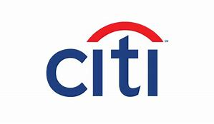




Migration Pathways
Flex to Angular
(60%-70%)
Grammar based
VB to .NET
(60%-80%)
Similar tech
NMT based
Oracle to PostgreSQL
(70%-90%)
Rule based
WebLogic to JBOSS
(80%-90%)
Struts to Spring
(50%-60%)
Migration Paths
Dissimilar tech
Grammar based
Oracle JDK to OpenJDK
(60%-70%)
Oracle Forms to Angular, COBOL to Java
(poor code maintainability)
Grammar based
Re-engineering
PL1 to Java
(90%-100%)
C to Java
(30-40%)
Mainframe rule extraction
(50%-60%)
Auto-complete based
Python, Java development
(30%-40%)

Slide 30
DATA LANDSCAPE MODERNIZATION

Slide 31
Data Landscape Modernization – Operations Evolution
Current Mode of Operations
Modernization Patterns
Future Mode of Operations
User Experience
Cumbersome, non user-centric, rigid & complex
Steep learning curve
Desktop only
Architecture
Monolith, Batch centric
Data silos
Technology
Proprietary, SQL (Oracle, Informatica…)
Appliance based (Teradata, Netezza…)
Consumption
Data Extracts, Reports, Dashboards
Operations
Siloed teams
Point automations
User Experience
Engaging, appealing, user-centric
Personalized and unified experience across all devices
Architecture
Cloud native, real time, distributed, Metadata driven, ML driven
Technology
Open Source, cloud, NoSQL, Graph DB
Consumption
Data Services, Exploration, Chatbots, Push Notifications, Data Catalog, Feature Store etc
Operations
Unified Operation across Hybrid landscape
Managed Services
Integrated DevSecOps teams
Automation-native
Appliance to Cloud DW Migration
ETL tools/SQL to Open Source/Cloud Native ETL
Serverless ETL adoption
Hybrid Data Pipelines
Hadoop Data Lake to Cloud Migration

Slide 32
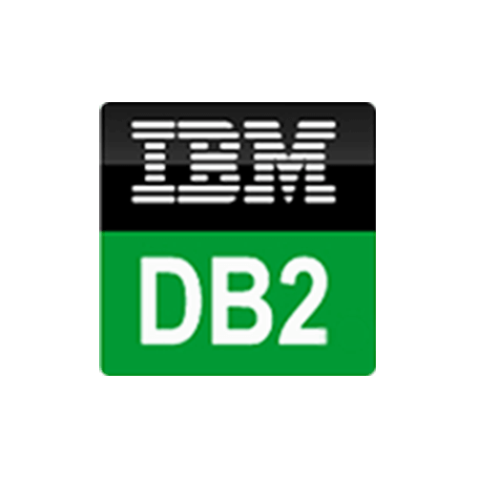
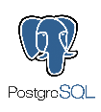

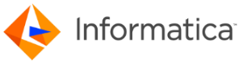


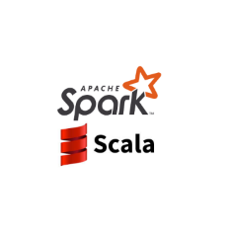
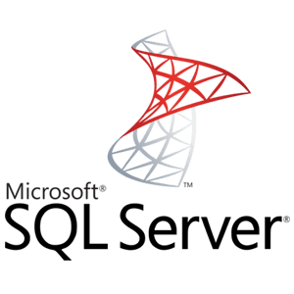
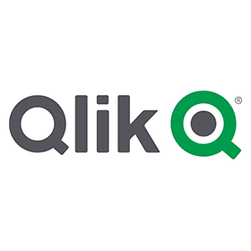


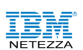

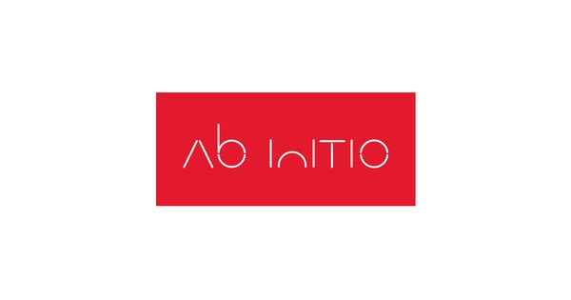
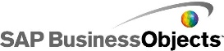



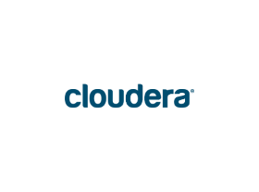
Data Landscape Modernization
Goal
Accelerate data estate modernization and simplification by 30-40% through engineering driven automation
Modernization Paths
Migrate to Snowflake
Migrate to Big Query
Hadoop to S3/ADLS
ETL tool to ADF
Key Features
Existing
Upcoming
CLOUD ADOPTION STRATEGY
DW/Data Lake Assessment
Code Assessment
Report Assessment
Business Case Creation
User Certification
Data Store Recommendation
Rationalization Engine
What-if analysis
MIGRATION/ MODERNIZATION
Data & Schema Migration
ETL Code
Conversion*
SQL Code
Conversion
Addition of new Sources & Targets
Semantic Layer Migration
Report Migration
Data Diagnostics
Integrated Monitoring
Reporting and Analytics
Additional Services
CLOUD DATA
ESTATE MGMT
Preventive Maintenance
Ticket Lifecycle View
SOURCE & TARGETS
Technologies supported: 19
Based on Open Source
* 3rd Party tools

Slide 33
Data Landscape Modernization
END-STATE – 30%- 40% AUTOMATION
CLOUD ADOPTION STRATEGY
MIGRATION/MODERNIZATION
CLOUD DATA ESTATE MGMT
DW/Data Lake Assessment
Code Assessment
BI Landscape Assessment
Data Store Recommendation
Rationalization Recommendation
Data & Schema Migration
ETL Code Conversion
SQL Code Conversion
Semantic Layer Migration
Report Migration
Migration Validation
Data Diagnostics
Monitoring
Preventive Maintenance
* Highly automated
* Partially automated
KEY UPCOMING PRODUCTIVITY BOOSTERS
Additional Sources & Targets
SQL and ETL Migration
Cloud native ETL
Addition of new sources and targets for data migration
Automation of code migration from Legacy SQL scripts and ETL tools to Spark
Enhance Infosys Data Integration framework (IIG) to support Cloud Native services
Why?
Why?
Why?
There are a number of opportunities around migration from legacy data warehouses to Snowflake on Azure/AWS. Addition of additional capabilities will increase automation levels and help win deals
Most modernization programs involve code migration as well and the manual effort spent on code migration greatly increases program cost and timelines.
Most customers moving to cloud are looking for leveraging Cloud native services. Providing acceleration in creating pipelines using cloud native services will be a key value proposition
Benefits
Benefits
Benefits
Schema and data migration with up to 70% automation
Achieve 30-40% automation in migration of code with close to 70% for simple straight through processing jobs
Up to 50% automation in cloud data integration

Slide 34
Feature Rollout Plan – Data Landscape Modernization
6 weeks
12 weeks
18 weeks
Migration Patterns - Oracle to Snowflake
Assessment - Netezza, Teradata, Exadata, Informatica
AWS native processing using Glue, Lambda and Step Functions
Migration Patterns - Teradata to Snowflake/Redshift
Tool based landscape assessment
Snowflake and BigQuery Native transformations using DBT
Migration Patterns - Teradata to Synapse on Azure
Code Remediation – Informatica, Datastage
Code Migration – Informatica to PySpark, Ora to SF
Hybrid Data Pipelines – Scripts + Serverless + DBT
Data Landscape Modernization

Slide 35
Value Proposition and Next Steps

Slide 36
Infosys Value Proposition
Non disruptive renewal of IT landscape
Extreme Automation
Unlocking Data Value
Partner Ecosystem
Knowledge Curation
Full scale migration is not always necessary to drive value
Infosys uses a non-disruptive path to modernization through the ART – Accelerate, Renew and Transform framework
Infosys platforms accelerate all phases of modernization from knowledge curation from legacy systems to design and implementation accelerators for end state architecture
Supports 40+ modernization patterns across six modernization themes
Connecting data across the enterprise through unified business semantics to drive insights generation
ML driven automation to accelerate data integration and reducing time to insights
Democratized consumption to promote self-service exploration and consumption
Extensive ecosystem of 60+ partners including leading CSPs and open source vendors
Joint solution engineering and go to market campaigns
Partner supported capability building and research labs

Slide 37

Sales and Delivery enablement – sessions conducted (14), people covered (450+)
Client conversations – Fiserv, Gap, T-Mobile, NM
Upcoming – Vanguard(Retail), Avon, MetLife
Press Release - completed (10th Dec)
Sales playbook (3- 4 weeks)
Enablement sessions using Guided mentoring (4-6 weeks)
Rollout Plan

Slide 38
Appendix - INFOSYS MODERNIZATION SUITE

Slide 39
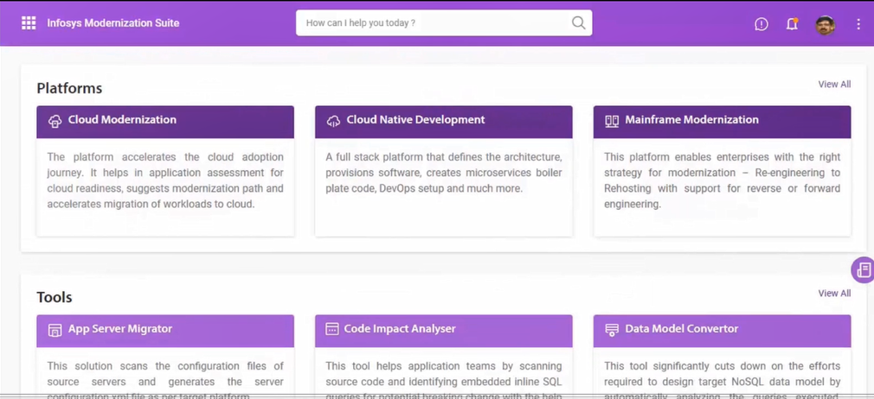
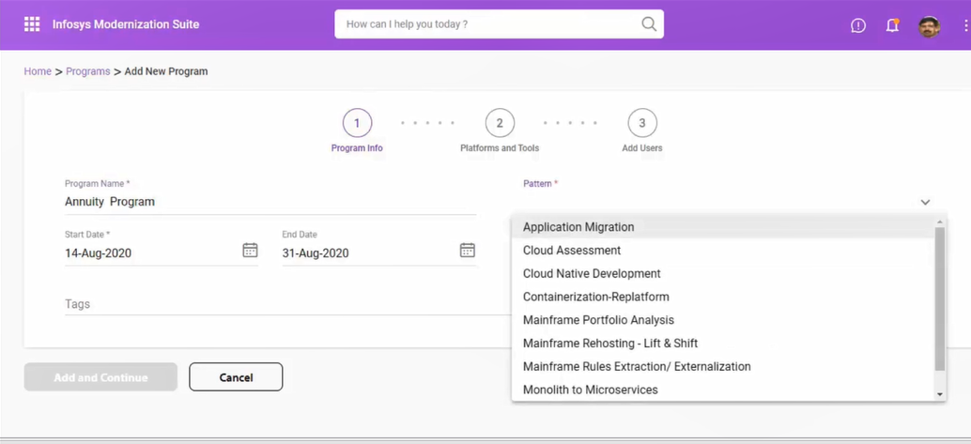
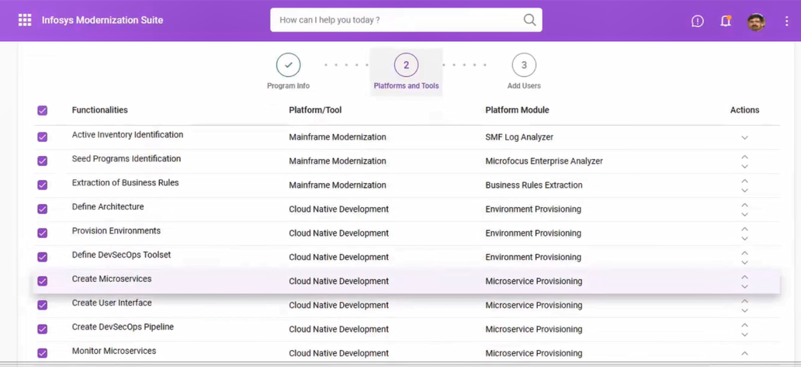
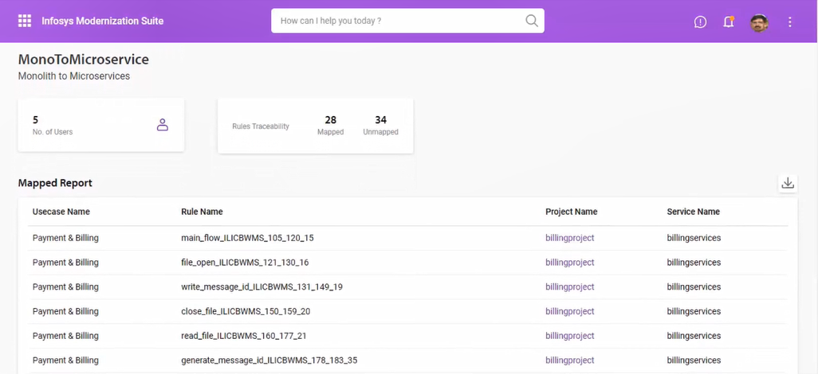
Infosys Modernization Suite

Slide 40
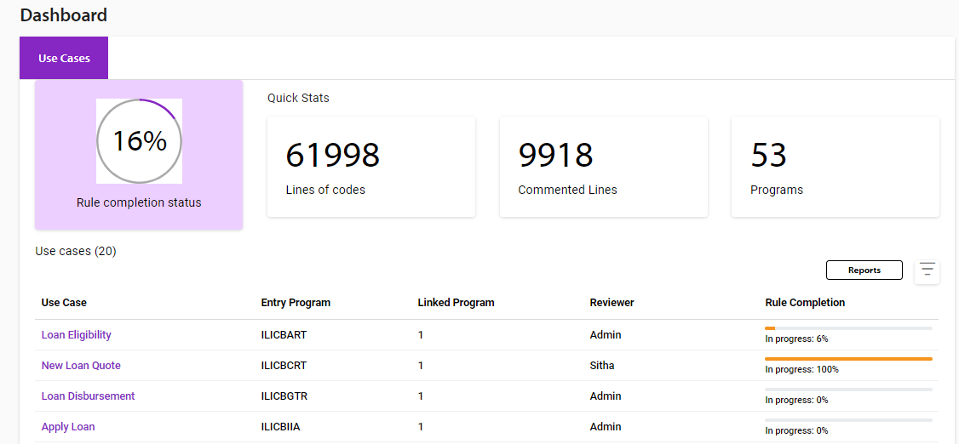
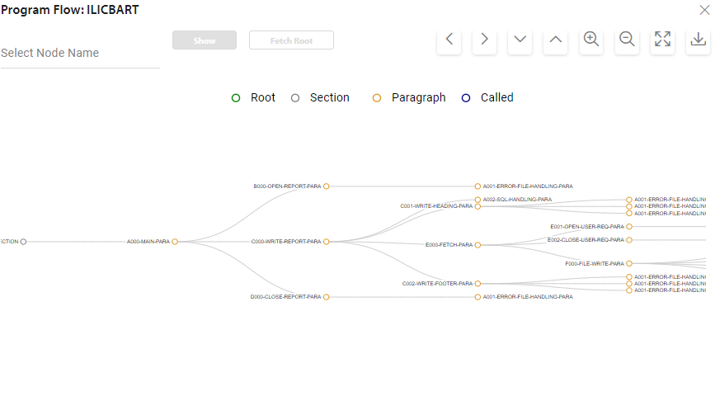
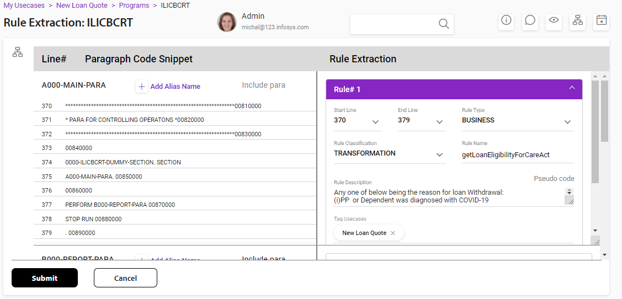
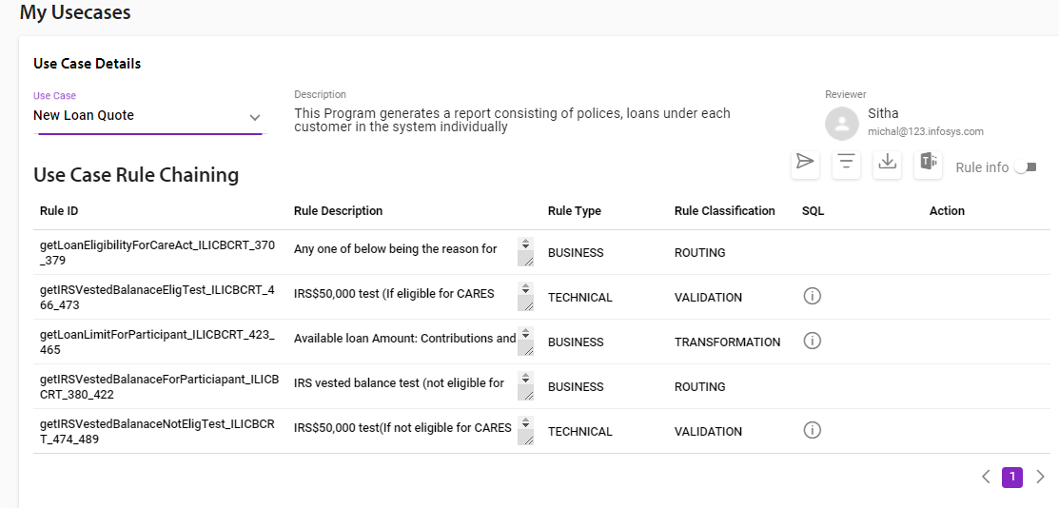
Mainframe Modernization Platform

Slide 41
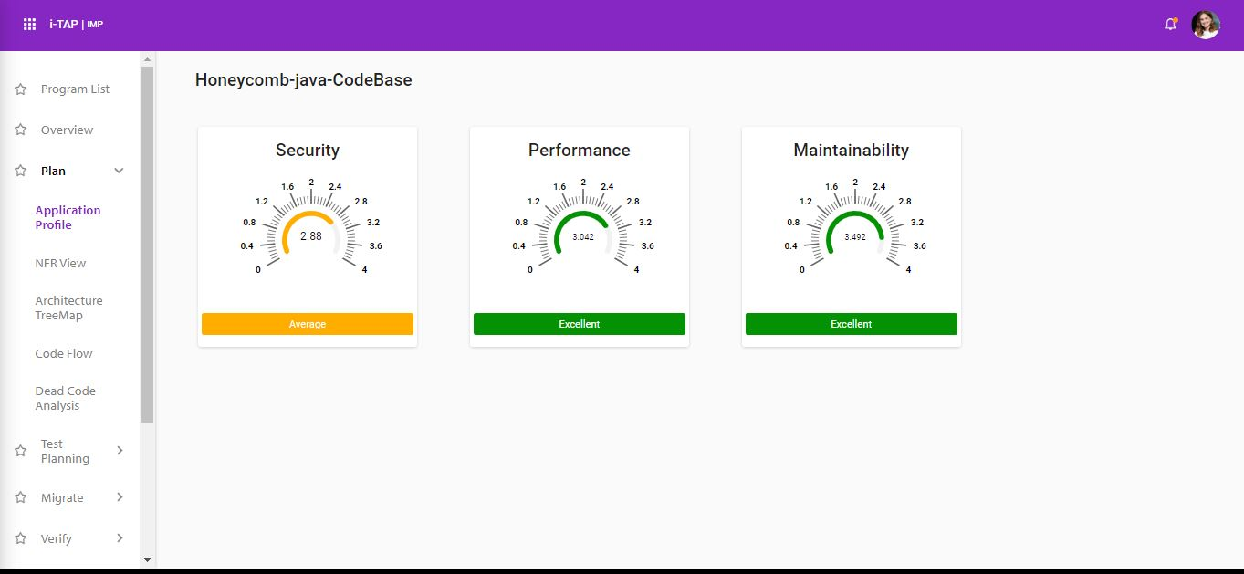
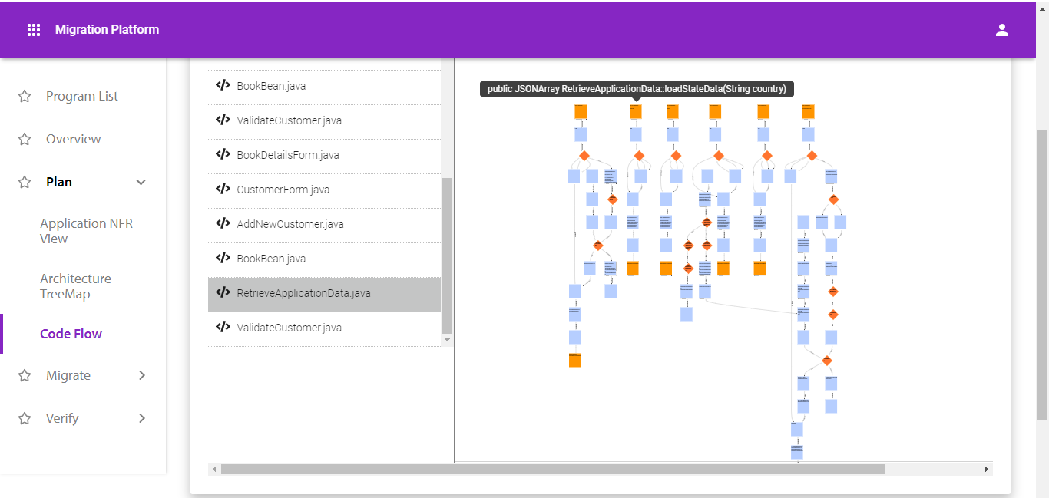
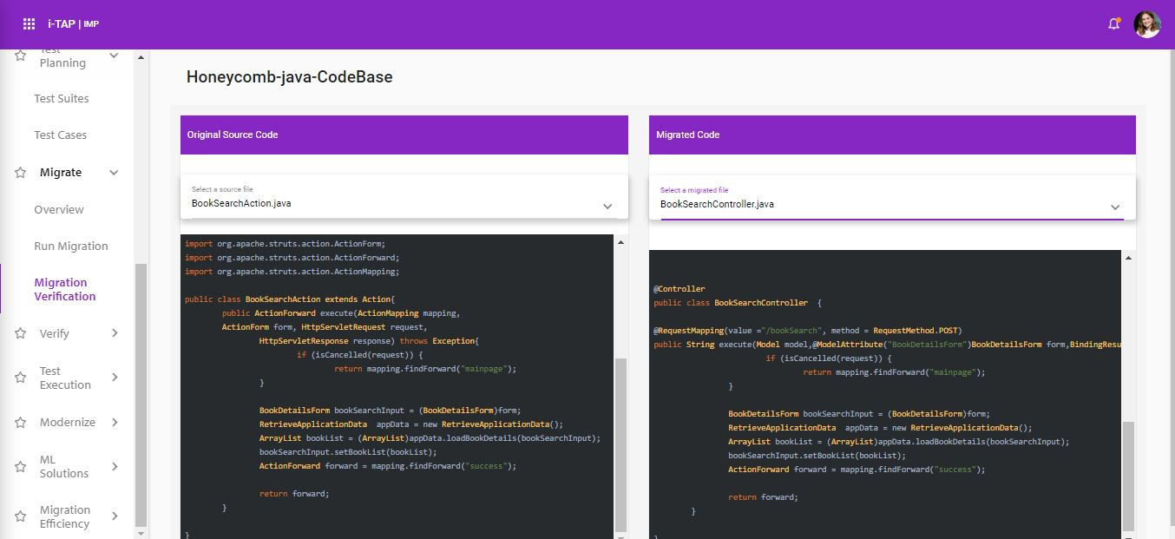
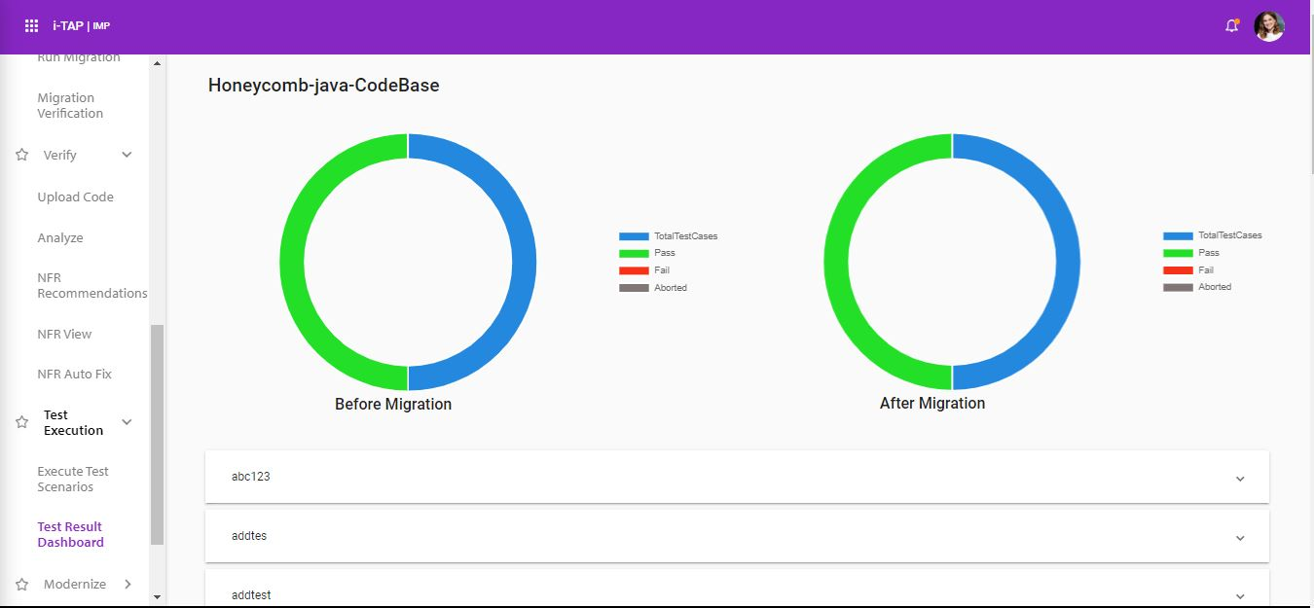
Application Migration Platform

Slide 42
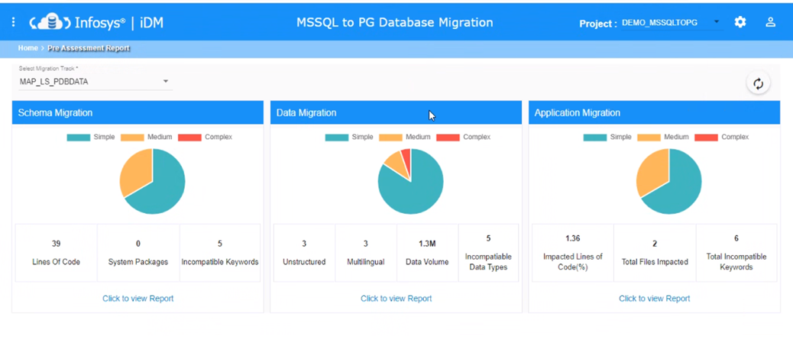
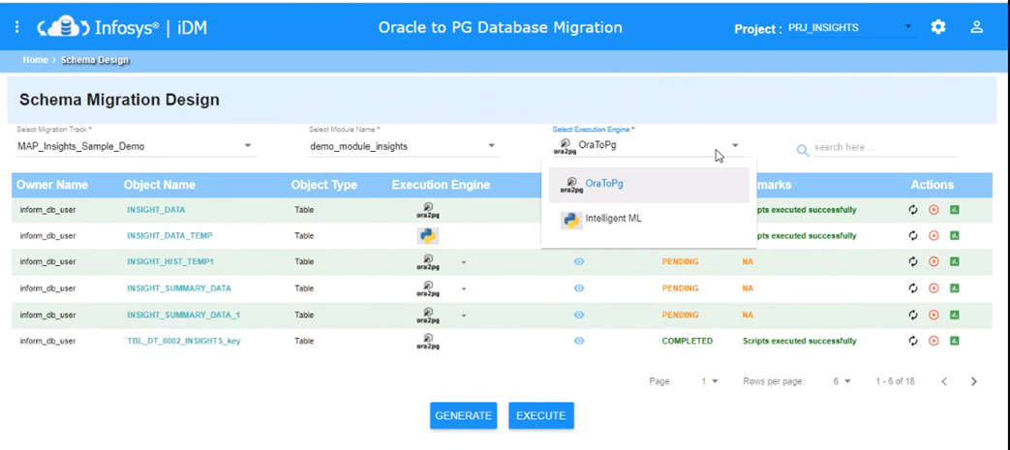
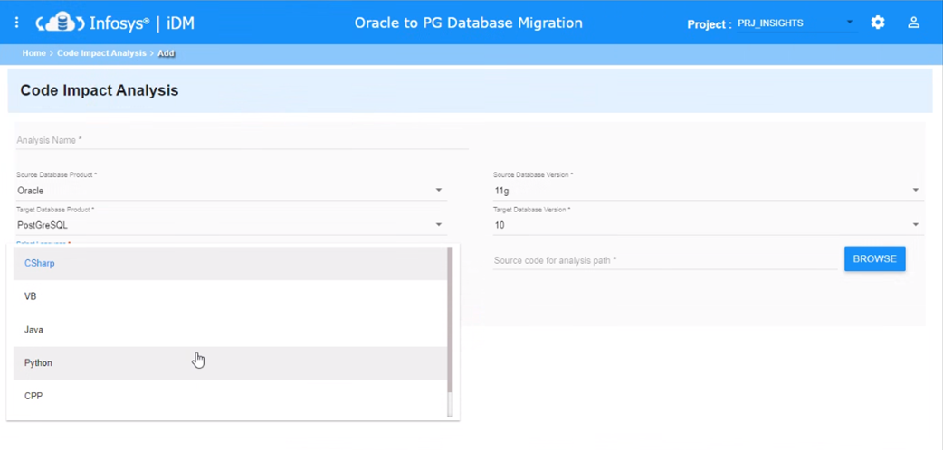
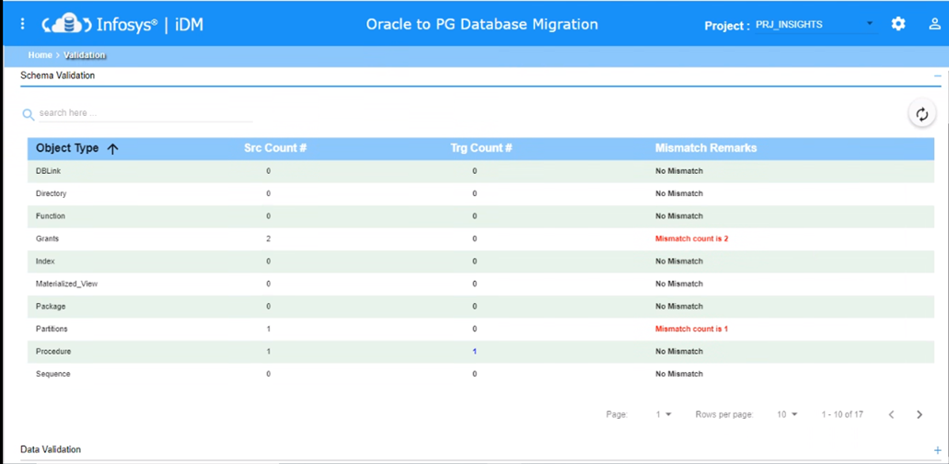
Database Migration Platform

Slide 43
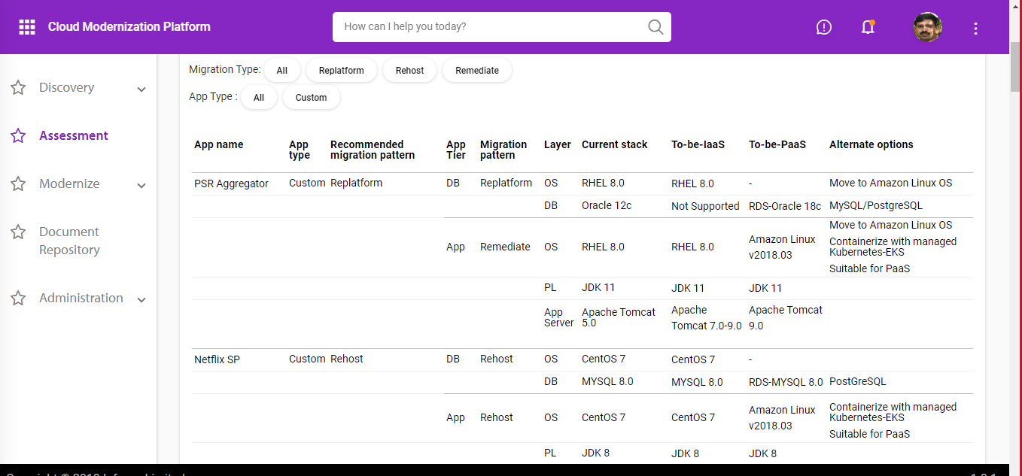
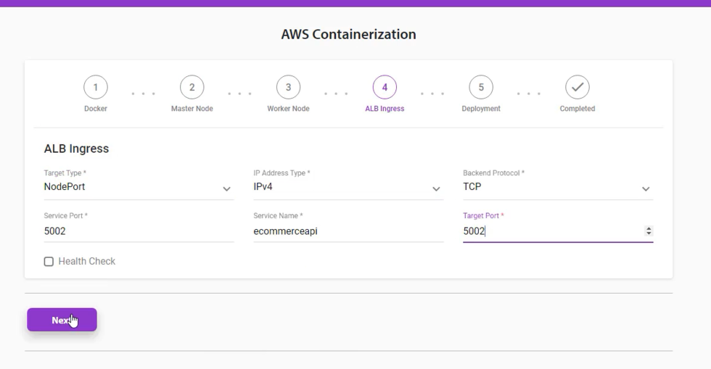
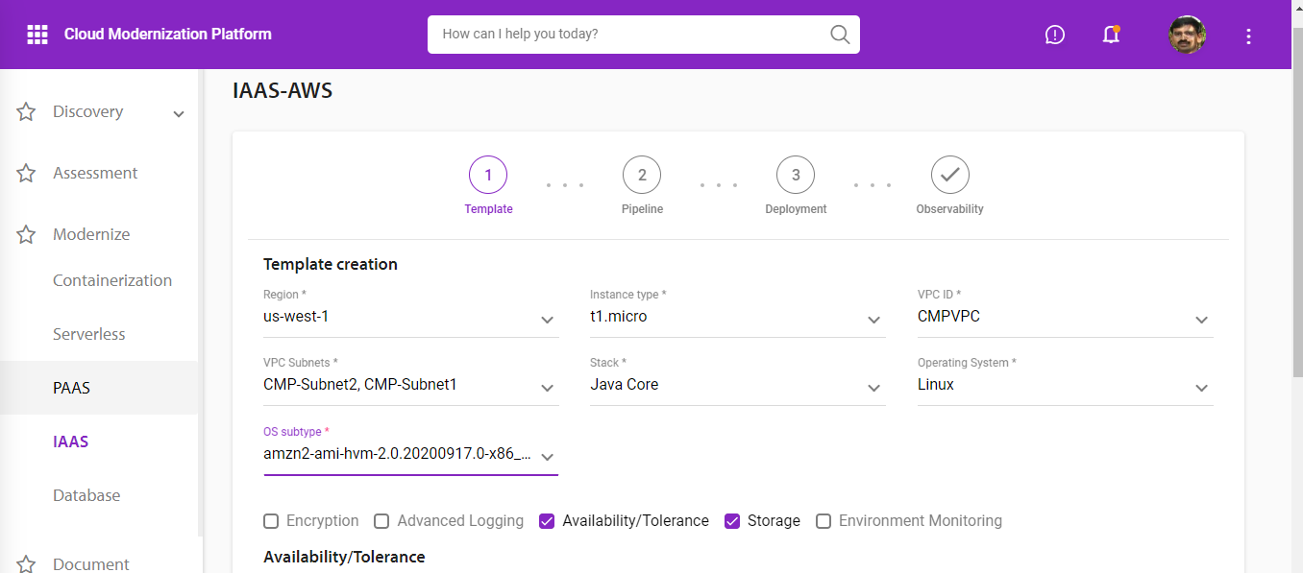
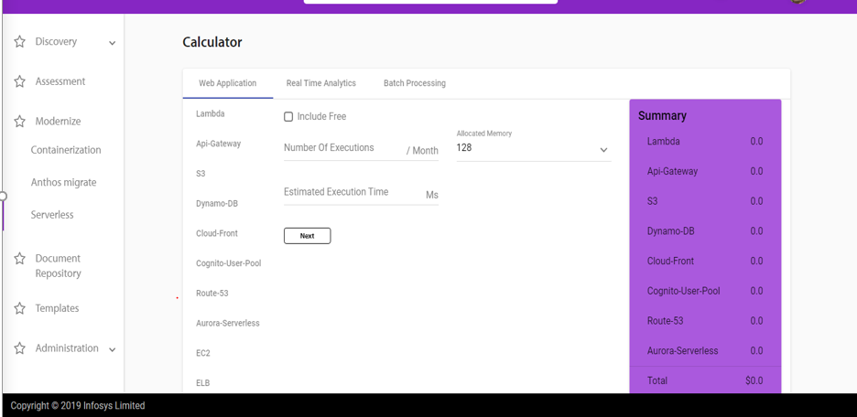
Cloud Modernization Platform

Slide 44
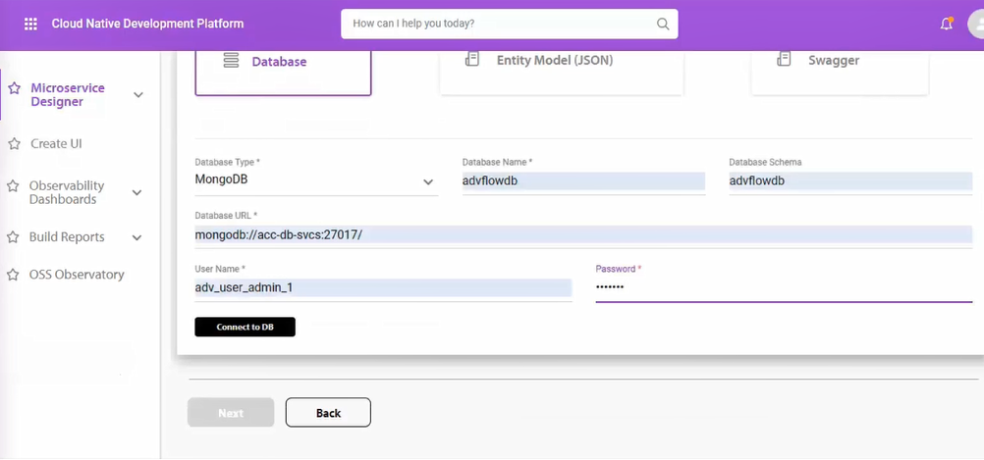
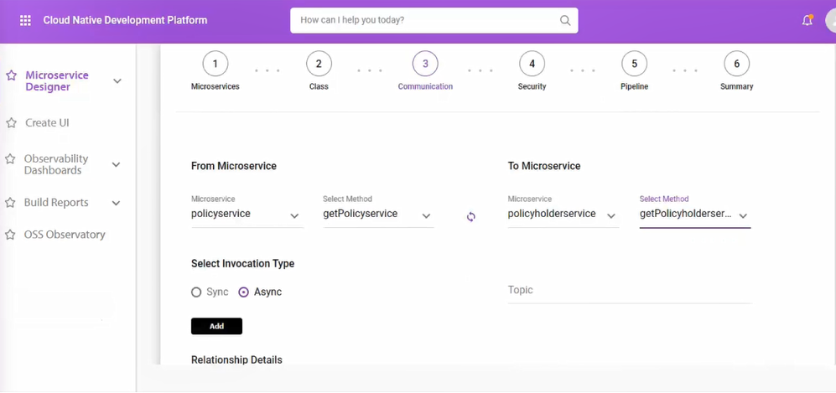


Cloud Native Development Platform

Slide 45
Appendix - Data Estate Modernization Suite

Slide 46






Data Landscape Modernization
Goal
Accelerate data estate modernization and simplification by 30-40% through engineering driven automation
CLOUD ADOPTION STRATEGY
MIGRATION/ MODERNIZATION
TO/ IN THE CLOUD
CLOUD DATA ESTATE MGMT.
Advisory and consulting services towards cloud adoption and Data Estate modernization strategies
Platform Monitoring, Automation, Cost Management, Performance Engineering, Data Platform Security
Database Migrations to Azure, Hadoop Migrations, Data Warehouse/ Appliance Migrations, AI/BI Platform migrations
SPARTAN – Portfolio Assessment Framework
Infosys Data Wizard
Infosys Data Operations Workbench
Enable Data Estate Modernization through accelerated migration of data, code and reports
DW Migration, Data Lake Migration, ETL & Report Migration
Unified operations console to cater to a hybrid data estate comprising of disparate tools and services
Assess, rationalize and prioritize legacy onprem workloads and arrive at dispositions and migration approach
30% acceleration in data estate management
Accelerate cloud migration journey by 15% and optimizes assets by 25%
Accelerate cloud migration journey by 30-40%
Information Grid
Template driven data integration, ML driven data mapping, Platform agnostic design time interface, Generative design to support multiple run time environments, cloud ready, enterprise data migration
50% acceleration in data integration
Partner
Ecosystem
Notes:
Tools:
Brex
Erwin
iDM
iDSS
iEDPS
iDW
iDTW
iCIA
DNA tools:
Infosys Information Grid (IIG)
Genome
Marketplace
Talking Points:
Vanguard solution involves moving data out from Mainframe using Attuinity as the CDC solution. Data is moved to an ODS from where IIG is used to populate the micro-DBs. ODS and micro-DBs are all RDS PostgreSQL. Reverse data flow from micro-DB to DB2 is still being solutioned.

Slide 47


Data Landscape Modernization – SPARTAN
Business Value
Fitness for Purpose
Dependencies and Relationships
Inventory of Assets and Capabilities
Retain
Invest
or
Create
Renew
Rationalization
Prioritization
Strategic Priorities
Standards & Trends
Retire
Technical Quality
Total Cost of Ownership
Technology Vendor Analysis
Reimagine
High
1
2
Road map
Service Model
Solution Blueprint
Cost & Benefit
5
12
20
3
4
Blueprinting
Business Value
10
15
7
8
Low
Low
Ease of Implementation
High
Notes:
Tools:
Brex
Erwin
iDM
iDSS
iEDPS
iDW
iDTW
iCIA
DNA tools:
Infosys Information Grid (IIG)
Genome
Marketplace
Talking Points:
Vanguard solution involves moving data out from Mainframe using Attuinity as the CDC solution. Data is moved to an ODS from where IIG is used to populate the micro-DBs. ODS and micro-DBs are all RDS PostgreSQL. Reverse data flow from micro-DB to DB2 is still being solutioned.

Slide 48

Data Landscape Modernization – Infosys Data Wizard
Comprehensive assessment framework that identify usage patterns of source data stores and recommends best suited target data store
1
5
Solution accelerators that help in migrating different types of Consumption Object inventory classes
Assessment
Consumption
Migration
Decision matrix to help identify the right approach for each type of data store
2
6
History Data Migration
Solution accelerators that help in migrating History Data to target Data Platform
Modernization Recommendation
Modernization
Accelerators
Solution accelerators that help in migrating different types of DB Object inventory classes
3
7
Testing and Validation
Comprehensive testing solution that accelerates validation of migrated assets
Database Object Migration
Solution accelerators that help in migrating different types of Data Processing Object inventory classes
4
8
Vendor partnerships complement migration framework and solutions
Code/ Pipline
Migration
Partner Ecosystem
Supported Sources
Supported Targets
Supported Target ETL
Notes:
Tools:
Brex
Erwin
iDM
iDSS
iEDPS
iDW
iDTW
iCIA
DNA tools:
Infosys Information Grid (IIG)
Genome
Marketplace
Talking Points:
Vanguard solution involves moving data out from Mainframe using Attuinity as the CDC solution. Data is moved to an ODS from where IIG is used to populate the micro-DBs. ODS and micro-DBs are all RDS PostgreSQL. Reverse data flow from micro-DB to DB2 is still being solutioned.

Slide 49

Data Landscape Modernization – Infosys Information Grid
Accelerated Time to Market for Data Supply Chain
Seamless Interface with Extreme Automation
Intuitive and personified UI
Metadata driven Data Flow generation
Extreme Automation with one click server instantiation and CI-CD
No Vendor Lock in
Prefabricated Design Templates
Comprehensive Data Foundation Management
Multi point Data Ingestion
Attribution History Maintenance
Data Lifecycle Management
Syntax and Semantic Validation
Data Egress
Infosys Information Grid
ML based data engineering services
Metadata Driven Data Processing Framework
Secure Data Foundation
Integration with Cloud Key Stores
Encryption of sensitive metadata
Role based Security
Cloud Platform Native and Technology Agnostic
Component Neutral Architecture
Technology Abstraction
Source agnostic Code generation
Data operators for technology agnostic execution
Cloud native technologies for server less execution
Cloud Support
ML based features
Auto Data Mapper
ML based Cleansing
DQ rule recommender
Entity Resolution
Notes:
Tools:
Brex
Erwin
iDM
iDSS
iEDPS
iDW
iDTW
iCIA
DNA tools:
Infosys Information Grid (IIG)
Genome
Marketplace
Talking Points:
Vanguard solution involves moving data out from Mainframe using Attuinity as the CDC solution. Data is moved to an ODS from where IIG is used to populate the micro-DBs. ODS and micro-DBs are all RDS PostgreSQL. Reverse data flow from micro-DB to DB2 is still being solutioned.

Slide 50
Data Landscape Modernization – Infosys Data Operations Workbench
Module 1 - Data Diagnostics
Module 2 – Integrated Monitoring
Module 3 – Preventive Maintenance
Outcomes
Unified operations view for all platforms (On-Prem & Cloud)
Holistic view of Data Pipeline
Cluster Usage Optimization
Self healing and Ticket elimination
End to End Data Usage Diagnostics
Automation, Reduction in Manual work
LOB and Application level operational and usage metrics
Helps usage-based pricing
Cost optimization recommendations
Identify unused data
Charge back analysis for data usage
Monitor end to end data ingestion pipeline across all ETLs
Integrated Metadata
Core platform health monitoring across on prem and cloud
Core Applications health and service monitoring
Single console view
Preventive alerts for all platforms across on prem and cloud
Trend analysis
SLA Violation Alerts
Integration to Data Quality reports
Anomaly detection
Self Healing
Infosys Data Operations Center (DOC)
Disparate data technologies with varied governance levels needs an integrated solution to address the problems
Module 4 – Ticket Lifecycle View
Module 5 – Reporting and Analytics
Integration to remedy /service now
Ticket generation in case of issues or slowness
Ticket status
Ticket Analytics
Data and resource usage reports
Platform Availability reports and Analysis
Persona based Reports
Capacity forecasting
Service delivery reports
Teradata
Informatica
Hadoop
Spark
HBase
BI Tools
Azure
AWS
GCP
Server Health
Talend
ELK/Splunk
Notes:
Tools:
Brex
Erwin
iDM
iDSS
iEDPS
iDW
iDTW
iCIA
DNA tools:
Infosys Information Grid (IIG)
Genome
Marketplace
Talking Points:
Vanguard solution involves moving data out from Mainframe using Attuinity as the CDC solution. Data is moved to an ODS from where IIG is used to populate the micro-DBs. ODS and micro-DBs are all RDS PostgreSQL. Reverse data flow from micro-DB to DB2 is still being solutioned.

Slide 51




THANK YOU
© 2020 Infosys Limited, Bengaluru, India. All Rights Reserved. Infosys believes the information in this document is accurate as of its publication date; such information is subject to change without notice. Infosys acknowledges the proprietary rights of other companies to the trademarks, product names and such other intellectual property rights mentioned in this document. Except as expressly permitted, neither this documentation nor any part of it may be reproduced, stored in a retrieval system, or transmitted in any form or by any means, electronic, mechanical, printing, photocopying, recording or otherwise, without the prior permission of Infosys Limited and/ or any named intellectual property rights holders under this document.

